Slide 1

RISK MANAGEMENT
Sibish Ragul BHARATHI
Sasidharan DHAMODHARAN
Tuhin Tapas BARDHAN
Vishal NETHAJI

Slide 2

Summary chart – supplier 7

Slide 3
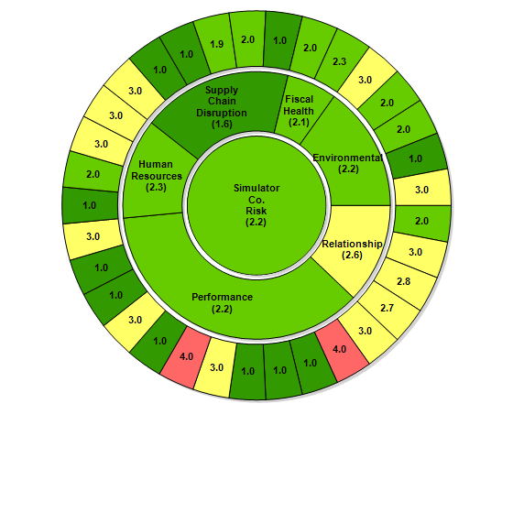
Con Co

Slide 4
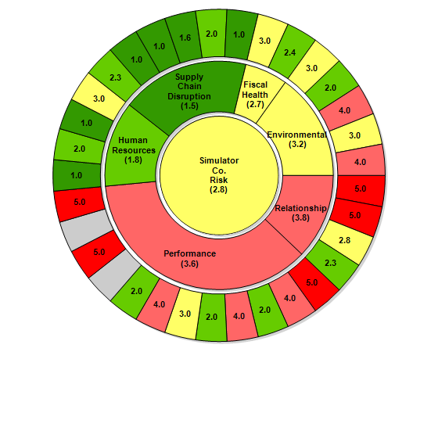
Will Co

Slide 5
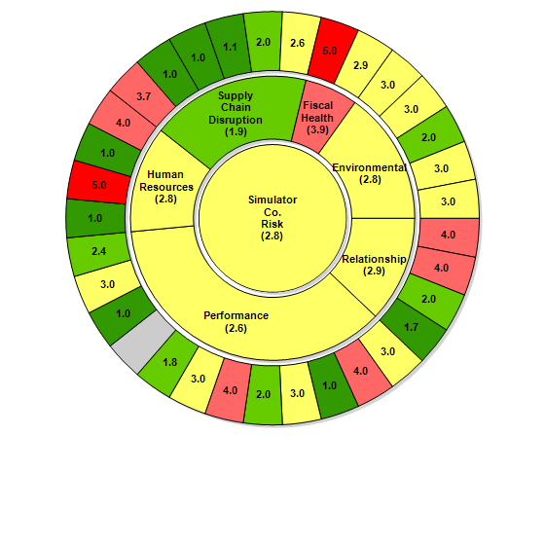
On Co

Slide 6
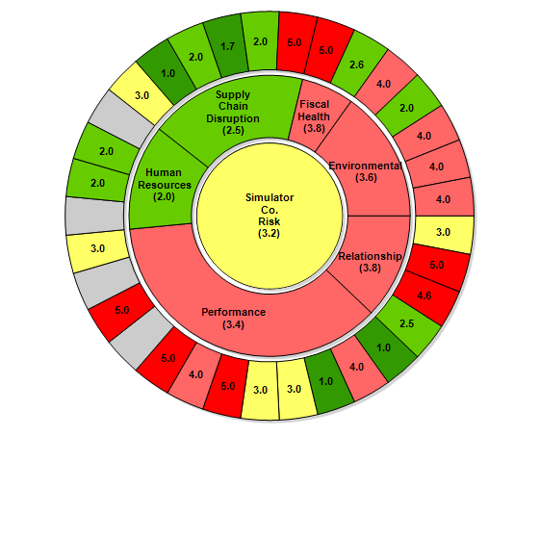
Vis Co

Slide 7
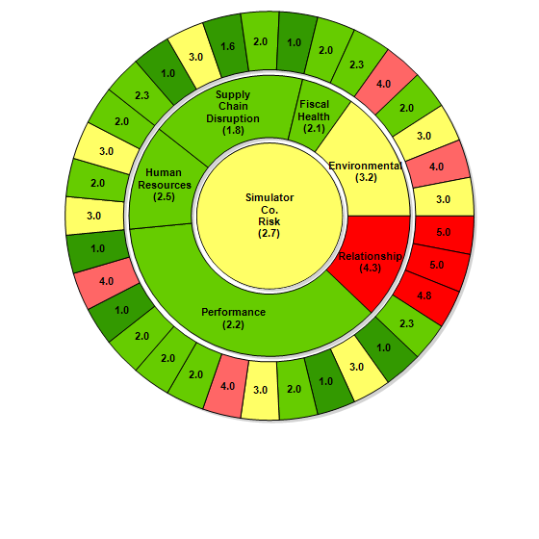
RED GROUP 1.Market Dynamics 2.Disaster 3.Supply Revenue from Truck components 4.Influence of Revenue from Simulator-co 5.Supplier/simulator Co. Alignment 6.Manufacturing Employees 7.Audit Score
1
2
Market Dynamics
Disaster
Supply Revenue from Truck components
Influence of Revenue from Simulator-co
Supplier/simulator Co. Alignment
Manufacturing Employees
Audit Score
3
4
7
5
6

Slide 8
1) Market dynamics
Arise of rental inventory leads to avoid inventory shortages when demand occurs.
Measure the forecast to avoid price hikes
Develop and share performance metrics to avoid material shortages.
2) Disaster
Avoiding development in landslide and flood prone areas
Transportation failure due to cargo theft, regulation changes, shipping damage, traffic
delays.
Civil war, protests, riots leads to supply chain disruptions
3) Supply Revenue from Truck Components
Building an relationship between supplier and Manufacturer
Controlling the cost of truck traffic
Changes in vehicle design like truck weight leads to avoid accident.
Truck components should be friendly for government authorities to avoid transportation
failure
4) Influence of Revenue from Simulator. Co
Giving more benefits to the supplier
Helping them with forecasting
Being more transparent
5) Supplier/Simulator Co. Alignment
Being transparent with the supplier
Giving favor to the supplier
6) Manufacturing Employees
Increases Skilled workers
Providing full training for new employees
7) Audit Score
Tie up with an external audit company
Do regular internal audit for every quarterly.
RED GROUP MITIGATION

Slide 9
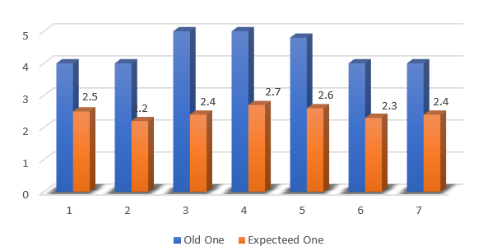
RED CHART

Slide 10
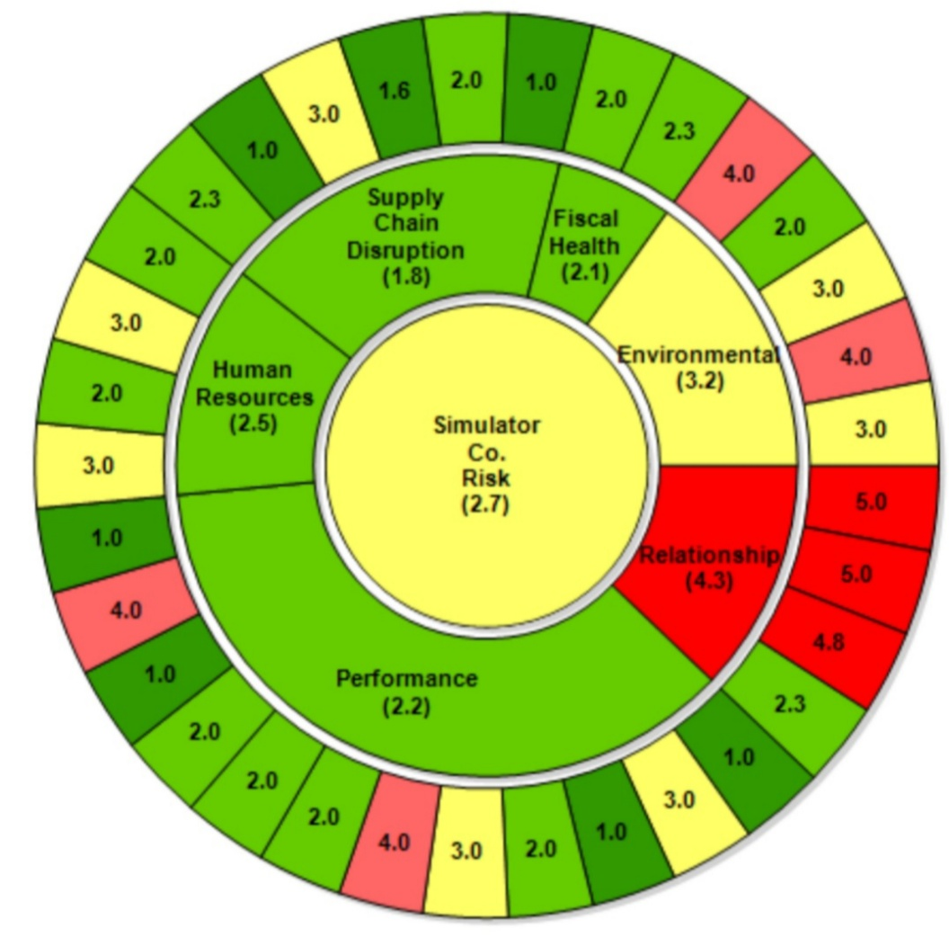
6
YELLOW GROUP
Employee Turnover
Delivery Flexibility
Engineering Support
Transportation
Regulatory
Tier II Performance Monitoring
Union Issues
7
5
4
1
3
2

Slide 11
YELLOW GROUP MITIGATION
1) Employee turnover
By providing health benefits and paid holidays yearly
2) Delivery flexibility
Giving sub-contract to third party delivery
Pre plan must be done for demand products
3) Engineering support
Continuous improvement
Hire humble and smart workers
4) Transportation
Train employees on safe
Improve warehouse inventory management
5) Regulatory
Sharing our technology, employees for training.
Guide them to minimize the effect of natural occurrence
and government regulations.
6) Tier II Performance Monitoring
Establish SPM strategy & planning
Develop performance criteria
7) Union issues
Develop good communication with workers
Competitive pay and benefits

Slide 12
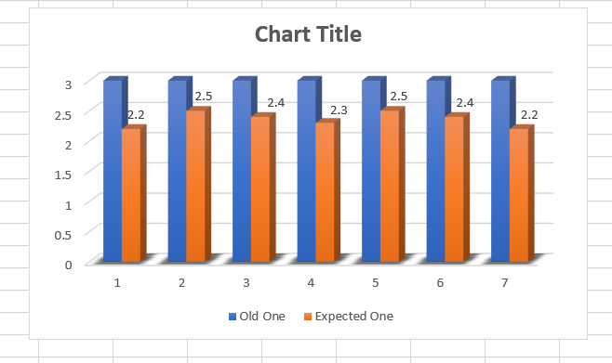
YELLOW CHART

Slide 13
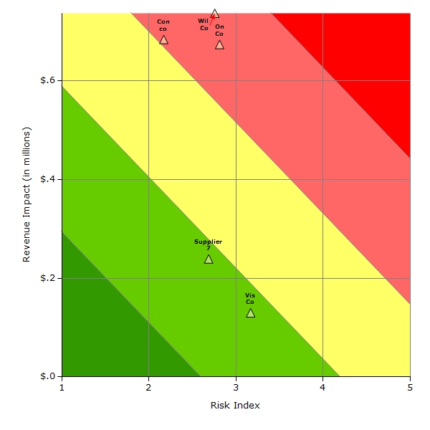
RISK DISTRIBUTION
TARGET

Slide 14
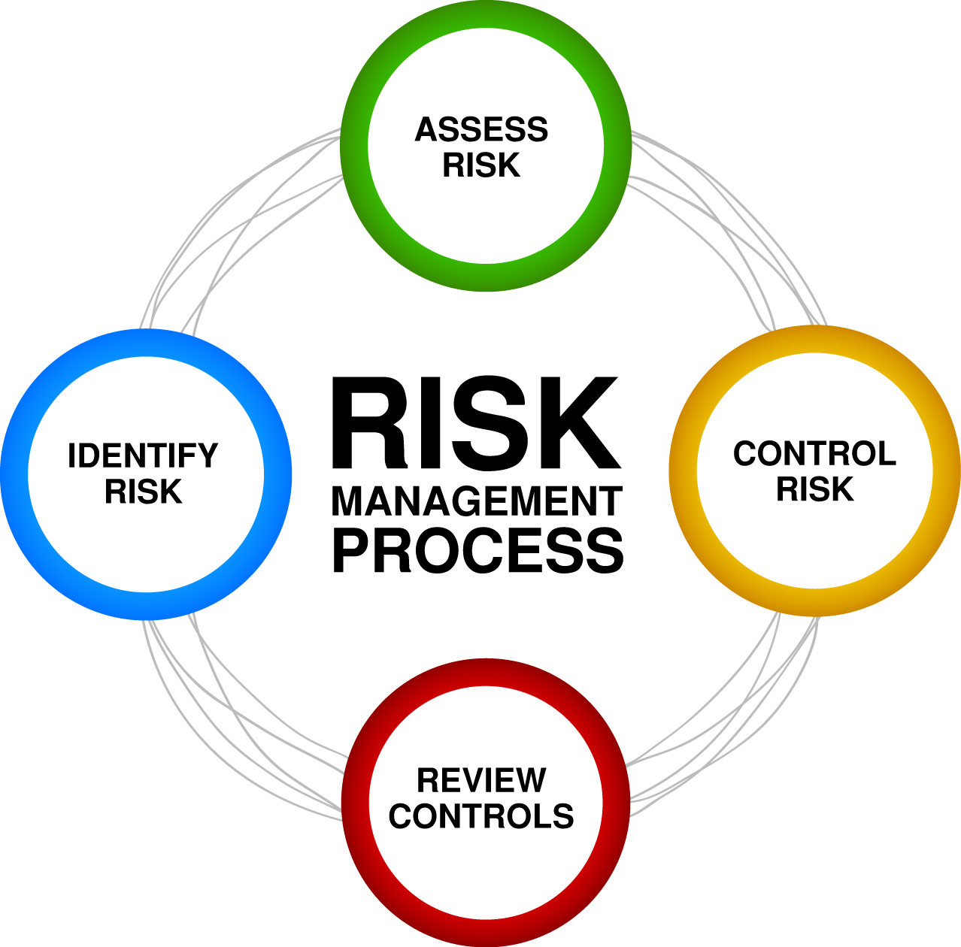
THANK YOU

